Slide 1
Intro to Flutter
DMIT 2504 Week 1 day 3

Slide 2





Announcements

Slide 3
Expectations
No Late Assignments
No Cheating
Be a good classmate
Don’t go to stupid sites in class
Show up to class

Slide 4
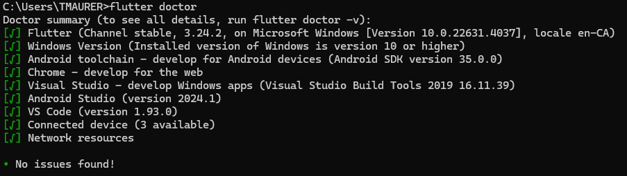
Flutter Doctor
Open up a terminal
Run flutter doctor
This checks your development setup for required files, sdks, licenses etc and attempts to fix any errors

Slide 5
Common Issues
Git error: git config --global --add safe.directory C:/dev/flutter
Missing licenses: flutter doctor --android-licenses
Command line tools missing: open android studio > tools > sdk manager > languages and frameworks > android sdk > sdk tools > android sdk command-line tools > apply

Slide 6
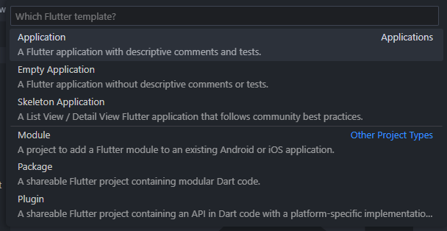
Create a Flutter Project
VS Code
Ctrl + shift + p
Flutter: New Project
Application
Terminal
Flutter create <path to create in>

Slide 7
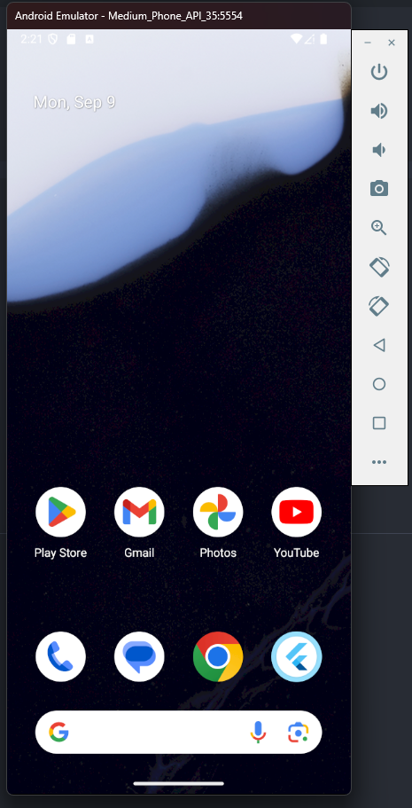
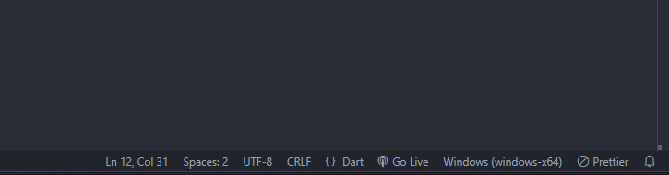
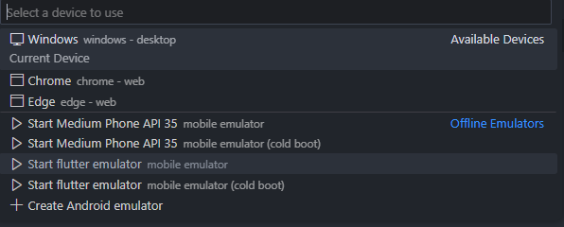
Selecting an emulator

Slide 8

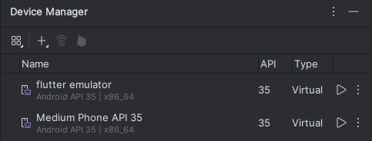
Adding an emulator
In Android Studio

Slide 9
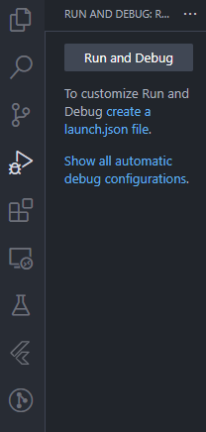
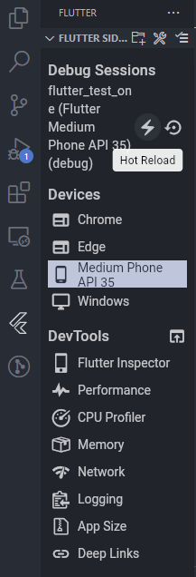
Run a flutter project
In VS Code
Ctrl + f5
F5
Using the sidebar
Reload in sidebar
In Terminal
flutter run
Reload with “r”

Slide 10
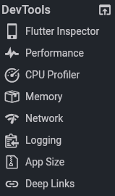
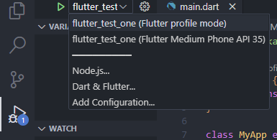
Flutter tools
Allows you to view and modify widget layout
View frame render stats
View network requests made by your app
View console output logs
Test deep links in your app
For some of these tools you need to run in profile mode
Notes:
Endpoint is a string
Are async

